Slide 1


Automated Packet Reporting System (APRS)
A Beginner’s Guide

Slide 2
Agenda
We hope these sample slides will help you create accessible presentations so that all attendees can access your research and stories.

Slide 3
Agenda
What is it?
Background
How Does it Work?
Examples
Equipment
Demonstration

Slide 4
So What is it?
The Automatic Packet Reporting System is an amateur radio-based system for real time tactical digital communications of information of immediate value in the local area.
APRS data is typically broadcast on a single shared frequency to be repeated locally by area relay stations and digipeaters for widespread local consumption.
In addition, all such data is typically ingested into the APRS Internet System (APRS-IS) via an internet connected receiver (igate) and distributed globally. Shared information contains global coordinates, altitude, speed, heading, text messages, alerts, announcements, and bulletins.
Source: aprs.org website, Bob Bruninga (WB4APR)

Slide 5
Some Background
Founded by Bob Bruninga, WB4APR, in the late 1980s.
Primarily used in amateur radio operations but adopted in various fields for data transmission.
Utilizes radio frequencies to transmit digital data packets.
Operates on VHF/UHF bands and supports text-based messaging, GPS information, and weather data.
Offers a network of interconnected stations (digipeaters) that relay information across a wide area.
Provides a platform for tracking vehicles, assets, weather stations, and individuals in real-time.
Promotes emergency communication and aids in search & rescue operations.
Enables users to access information via APRS websites and applications, providing a visual representation of transmitted data on maps.
Source: APRS.org, Wikipedia

Slide 6
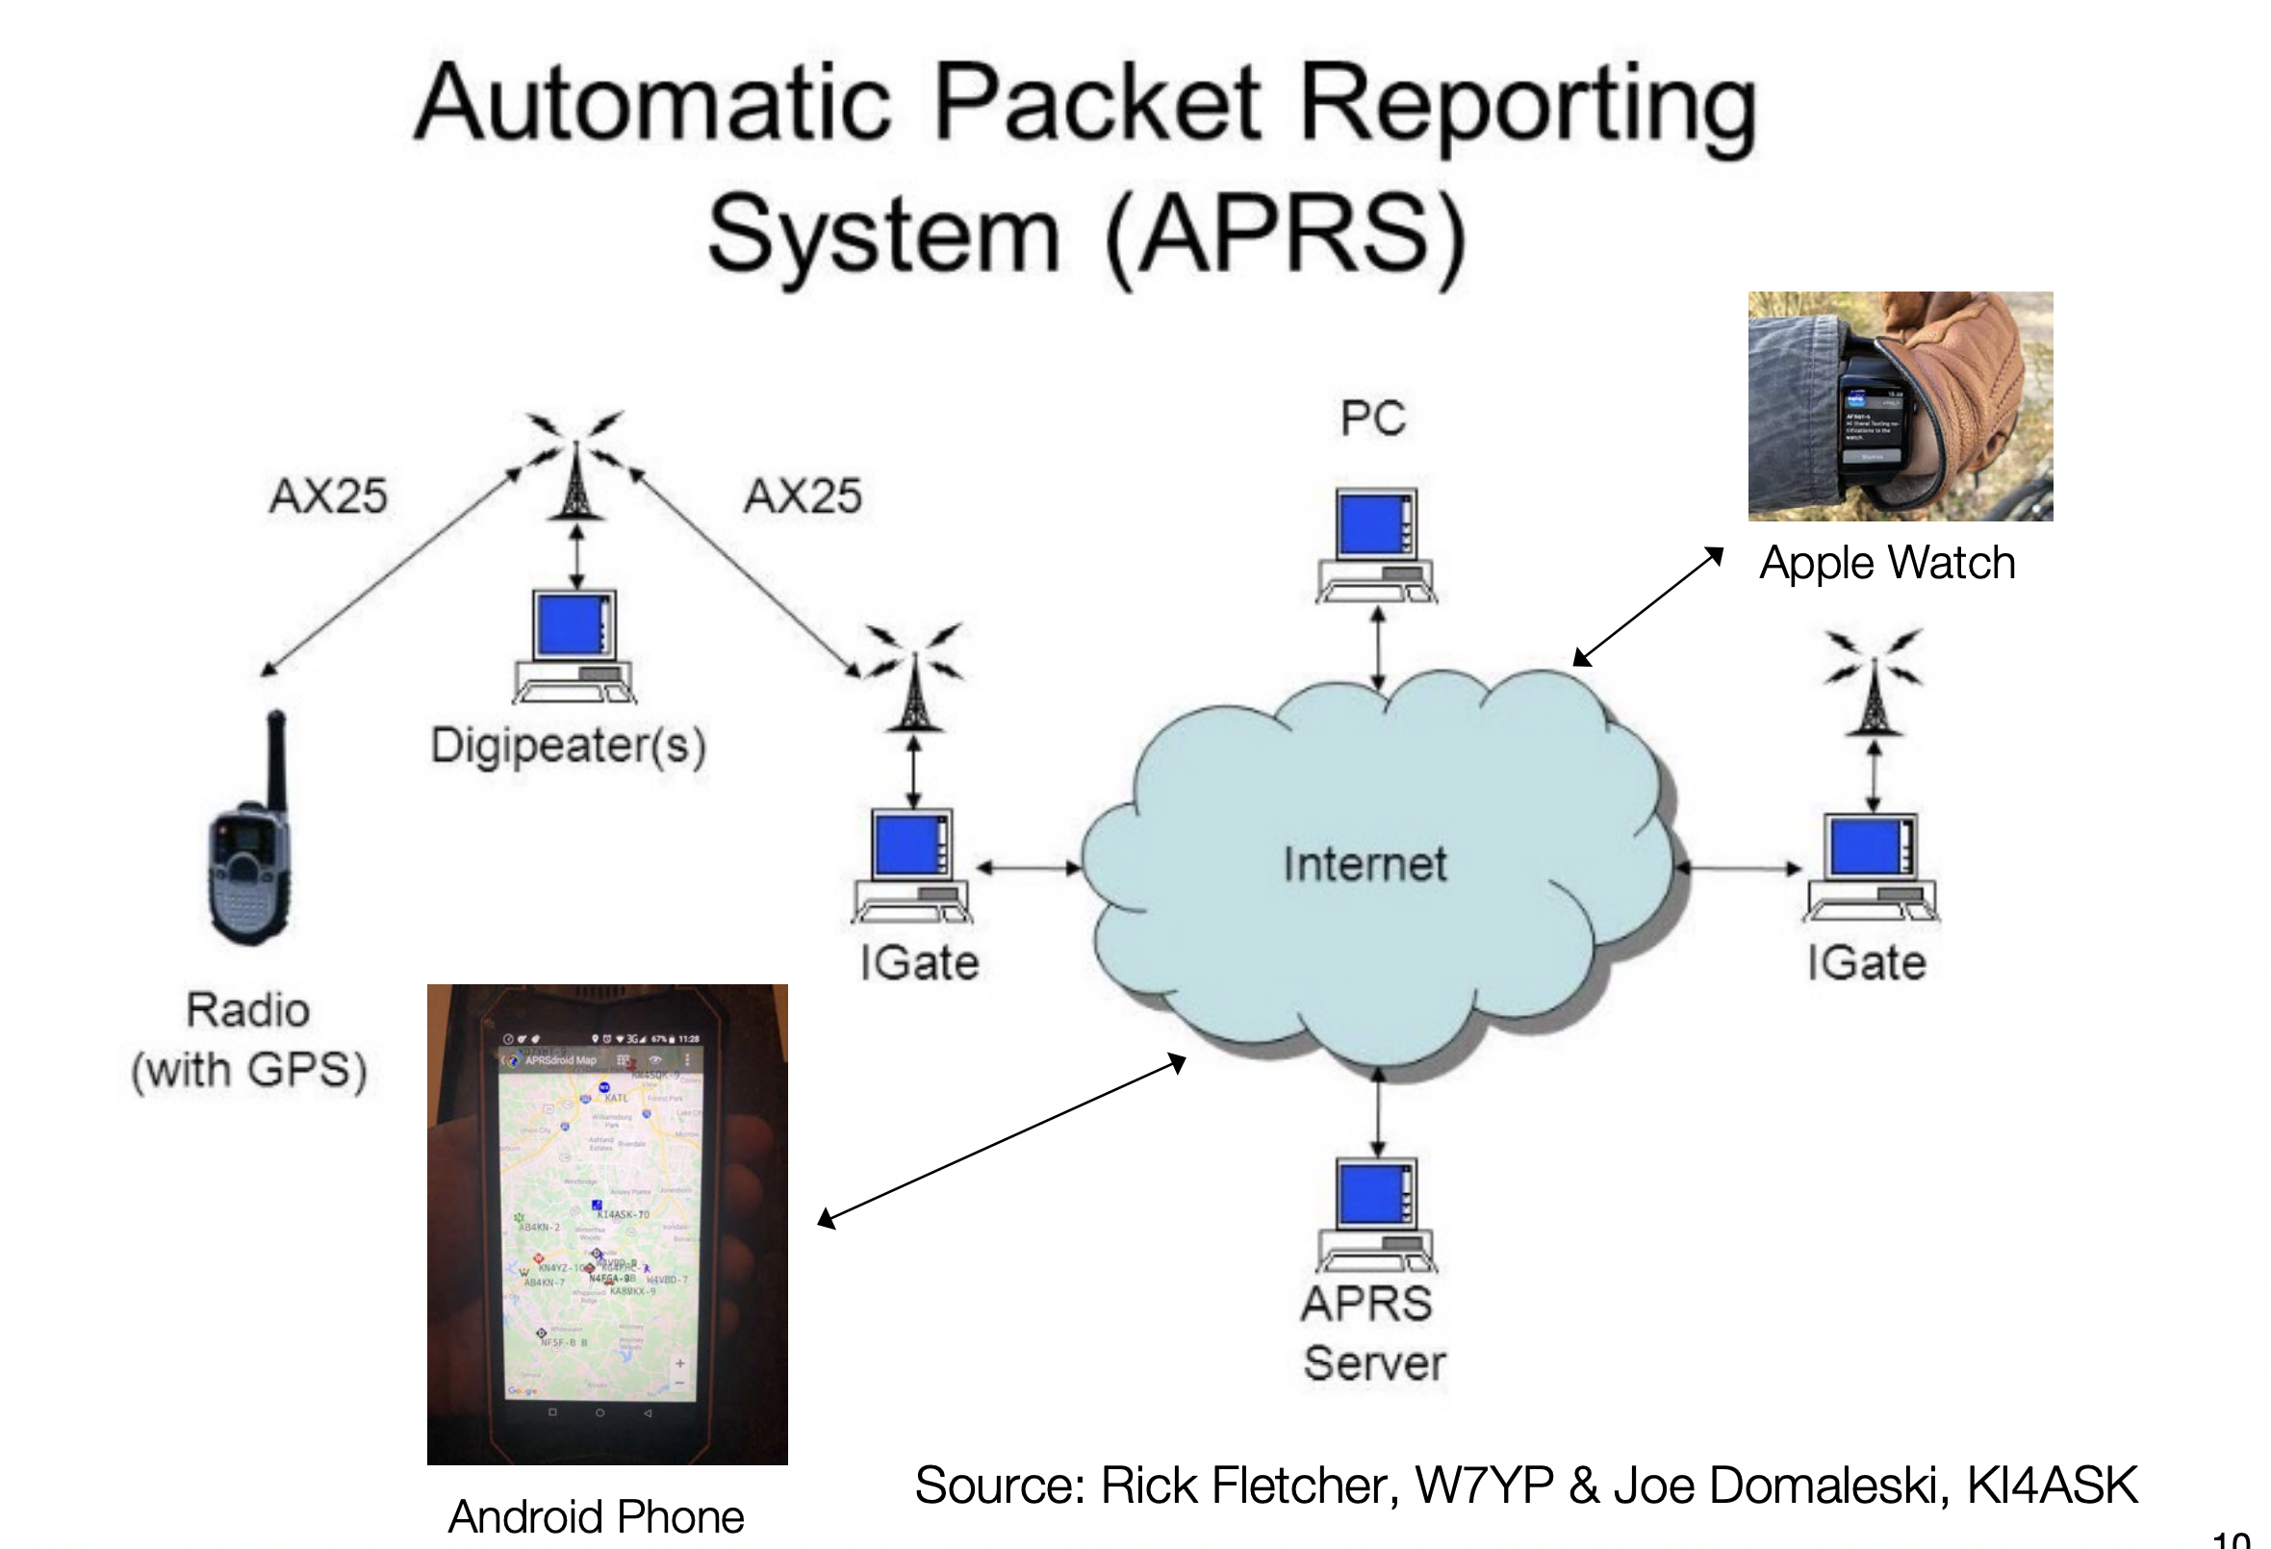
How Does it Work?
APRS networks usually involve various components:
Stations: These are nodes within the network, such as mobile or fixed stations equipped with APRS transceivers.
Digipeaters: These act as relay stations, receiving packets from stations and retransmitting them to extend the range of the network.
iGates: Internet Gateways that connect the APRS RF (Radio Frequency) network to the internet, allowing APRS data to be shared globally. They receive RF packets and upload them to APRS-IS (Automatic Packet Reporting System-Internet Service).
APRS-IS Servers: Servers that store and distribute APRS data received from iGates.
Clients/Applications: Various software applications or clients that access APRS data, displaying it in maps or using it for specific purposes (like weather stations, tracking systems, etc.).

Slide 7
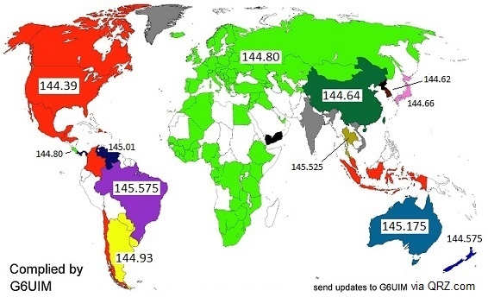
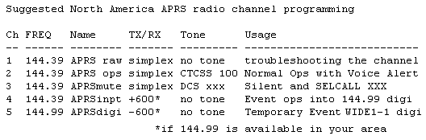
Frequency Map
APRS is used globally
North American has standardized on the VHF Frequency 144.39
Source: APRS.org

Slide 8
Sample Use Cases
Vehicle Tracking: APRS is often used to track the location of vehicles, such as ham radio operators participating in events, emergency response vehicles, or even personal vehicles. This can be useful in scenarios where real-time location information is crucial.
Weather Reporting: APRS can be employed to transmit weather information, including temperature, humidity, wind speed, and barometric pressure. Weather stations equipped with APRS transmitters can provide valuable data for local monitoring and forecasting.
Emergency Communications: During emergencies or disasters, APRS can serve as a reliable communication tool. It allows operators to exchange messages, send updates on conditions, and coordinate emergency response efforts. For example, can be used with SMS or a Winlink Gateway
Asset Tracking: Beyond vehicles, APRS can be used for tracking various assets. This is particularly useful in scenarios where keeping tabs on the location of equipment, supplies, or personnel is important.
Search and Rescue: APRS is valuable in search and rescue operations. Rescuers can track the movements of teams and receive location updates, improving coordination and efficiency in locating missing persons.
Hiking and Outdoor Activities: APRS can be utilized by hikers, campers, and outdoor enthusiasts to share their location with others. It enhances safety by allowing friends or emergency services to know their whereabouts. Can be used for POTA/SOTA Spotting (e.g. via APSPOT app)
Balloon Tracking: High-altitude balloons equipped with APRS transmitters are used to track the balloon's ascent and descent, providing valuable data for scientific experiments or educational purposes.
Unmanned Aerial Vehicles (UAVs): APRS can be integrated into UAVs to transmit real-time location information. This is beneficial for tracking drones and retrieving them in case of malfunctions or emergencies.

Slide 9
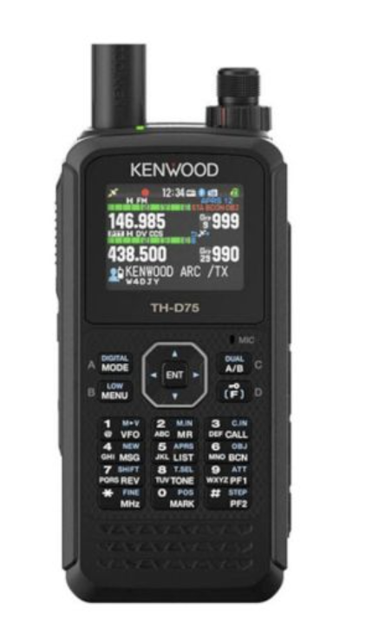
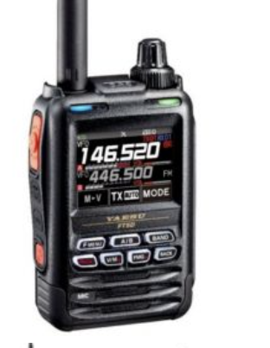

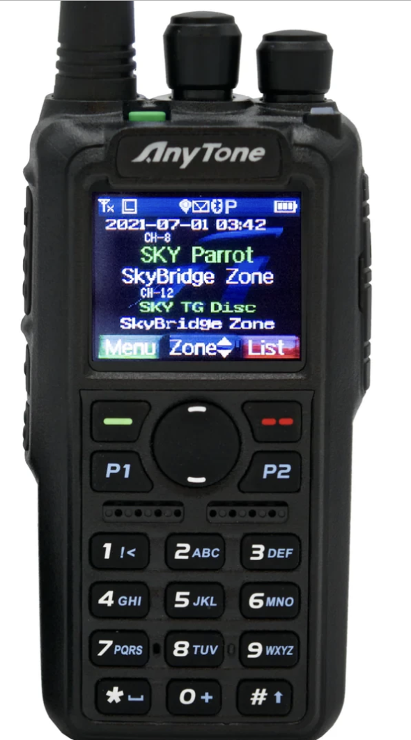
Some Popular APRS Radios
Kenwood TH-D74A: Known for its APRS capabilities, this handheld transceiver supports APRS data transmission and reception.
Yaesu FT5DR: Another handheld radio that supports APRS functionality and has GPS capabilities for APRS use.
Yaesu FTM-400XDR: This is a mobile transceiver that supports APRS and also features a touch-screen display for easier operation.
AnyTone AT-D878UV: This dual-band handheld radio supports APRS and DMR (Digital Mobile Radio).
Source: OEM websites

Slide 10
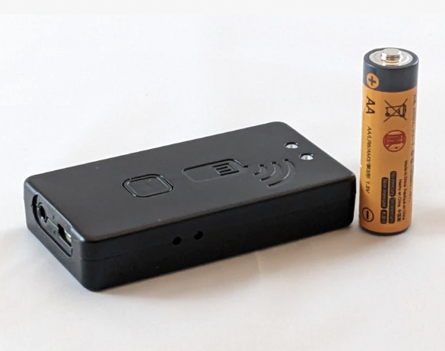


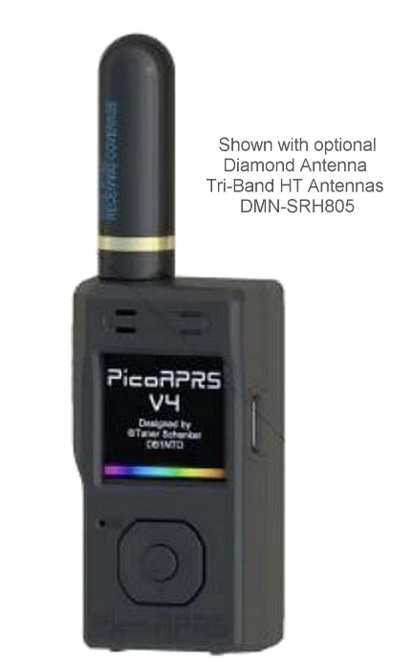
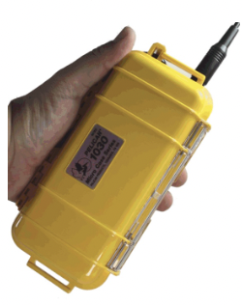
Related Technology for APRS
Peripherals
Mobilnk TNC: The TNC4 is designed for both APRS and general packet use. It is designed to interface with a wide range of mobile and base stations (as well as HTs).
Byonics: Provides TNCs and GPS Antennas for APRS applications
Self Contained Units
PICO APRS - a TNC and a GPS receiver included with the addition of a VHF 2-meter handheld transceiver.
Byonics AT-MIO: Self-contained APRS beacon
Source: DX engineering; Byonics website

Slide 11
APRS Mobile Applications
APRSdroid: APRSdroid is a popular Android application that allows users to send and receive APRS data on their mobile devices. It supports mapping, messaging, and other APRS functionalities.
APRS.fi: APRS.fi mobile app is a companion to the popular web-based platform that allows users to view real-time APRS data on maps. It also has capability to do APRS text messaging, beaconing, I-gate functionality (with subscription)
APRS TX – allows licensed Ham operators to beacon their position to the APRS-IS network using the internet (doesn’t use a radio)
PocketPacket: PocketPacket is an iOS application that enables users to connect to the APRS network. It provides features such as map displays, messaging, and beaconing.
Source: Apple and Google App stores

Slide 12
What do you need to get started?
End User Equipment: An APRS-capable radio OR VHF radio
TNC (e.g. Moblink TNC or Byonics)
GPS Source – GPS handheld or GPS antenna (bionics)
*Phone – Used for APRSDroid or APRS.Fi mobile apps
Your radio’s manual and/or addendum for configuring APRS. There is likely guidance on youtube as well. Configuring your radio is a critically important as it is going to enable you to communicate effectively (like getting CTCSS tones set correctly to access a repeater)
Knowledge of where your local Igates/Digipeaters are to ensure that your signal is hitting a repeater and getting into the APRS “system”
Access to APRS.fi and knowledge on how to search for your call sign.
Note: There is a method to just use your phone, but its not using any ham technology.

Slide 13
Advanced: Building an APRS I-gate
To build an Automatic Packet Reporting System (APRS) I-gate (Internet Gateway), you'll need the following components:
Hardware:
Radio Transceiver: APRS operates on the 2-meter band (144.39 MHz in the U.S.), so you'll need a VHF radio transceiver.
TNC (Terminal Node Controller): This device interfaces between your radio and the computer, encoding and decoding data for transmission.
Computer: A computer (like a Raspberry Pi) to run the APRS software and connect to the internet.
Software:
APRS Software: Install APRS software on your computer. Popular choices include Dire Wolf, APRX, and YAAC (Yet Another APRS Client).
Gateway Software: If not included in your chosen APRS software, you might need additional software to act as a gateway between the radio and the internet.
Digipeaters are not all that different, just configured differently.
Note 2: It is important that you research the correct configurations on both digipeaters and igates to avoid creating unnecessary clutter in the APRS network.

Slide 14
APRS SSIDs
SSIDs are used as an informal way of indicating one of several different typical APRS applications.
-0 Your primary station usually fixed and message capable
-1 generic additional station, digi, mobile, wx, etc
-2 generic additional station, digi, mobile, wx, etc
-3 generic additional station, digi, mobile, wx, etc
-4 generic additional station, digi, mobile, wx, etc
-5 Other networks (Dstar, Iphones, Androids, Blackberry's etc) -6 Special activity, Satellite ops, camping or 6 meters, etc
-7 walkie talkies, HT's or other human portable
-8 boats, sailboats, RV's or second main mobile -9 Primary Mobile (usually message capable)
-10 internet, Igates, echolink, winlink, AVRS, APRN, etc -11 balloons, aircraft, spacecraft, etc
-12 APRStt, DTMF, RFID, devices, one-way trackers*, etc
-13 Weather stations
-14 Truckers or generally full time drivers
-15 generic additional station, digi, mobile, wx, etc
Usually used in conjunction with a symbol that displays on the map
Source: APRS.org

Slide 15
APRS.fi Demo
Locating yourself via callsign
Locating igates/digipeaters

Slide 16
Summary
Harness Real-time Data: APRS enables real-time data communication and location tracking, providing instant insights for diverse applications.
Versatility Across Applications: Highlight the broad spectrum of applications, from amateur radio to emergency response and asset tracking, showcases APRS as a versatile tool.
Potential for Collaboration: Can be used for club activities like the Horse Endurance Race or the Tri-Lakes fun run.

Slide 17
Backup

Slide 18
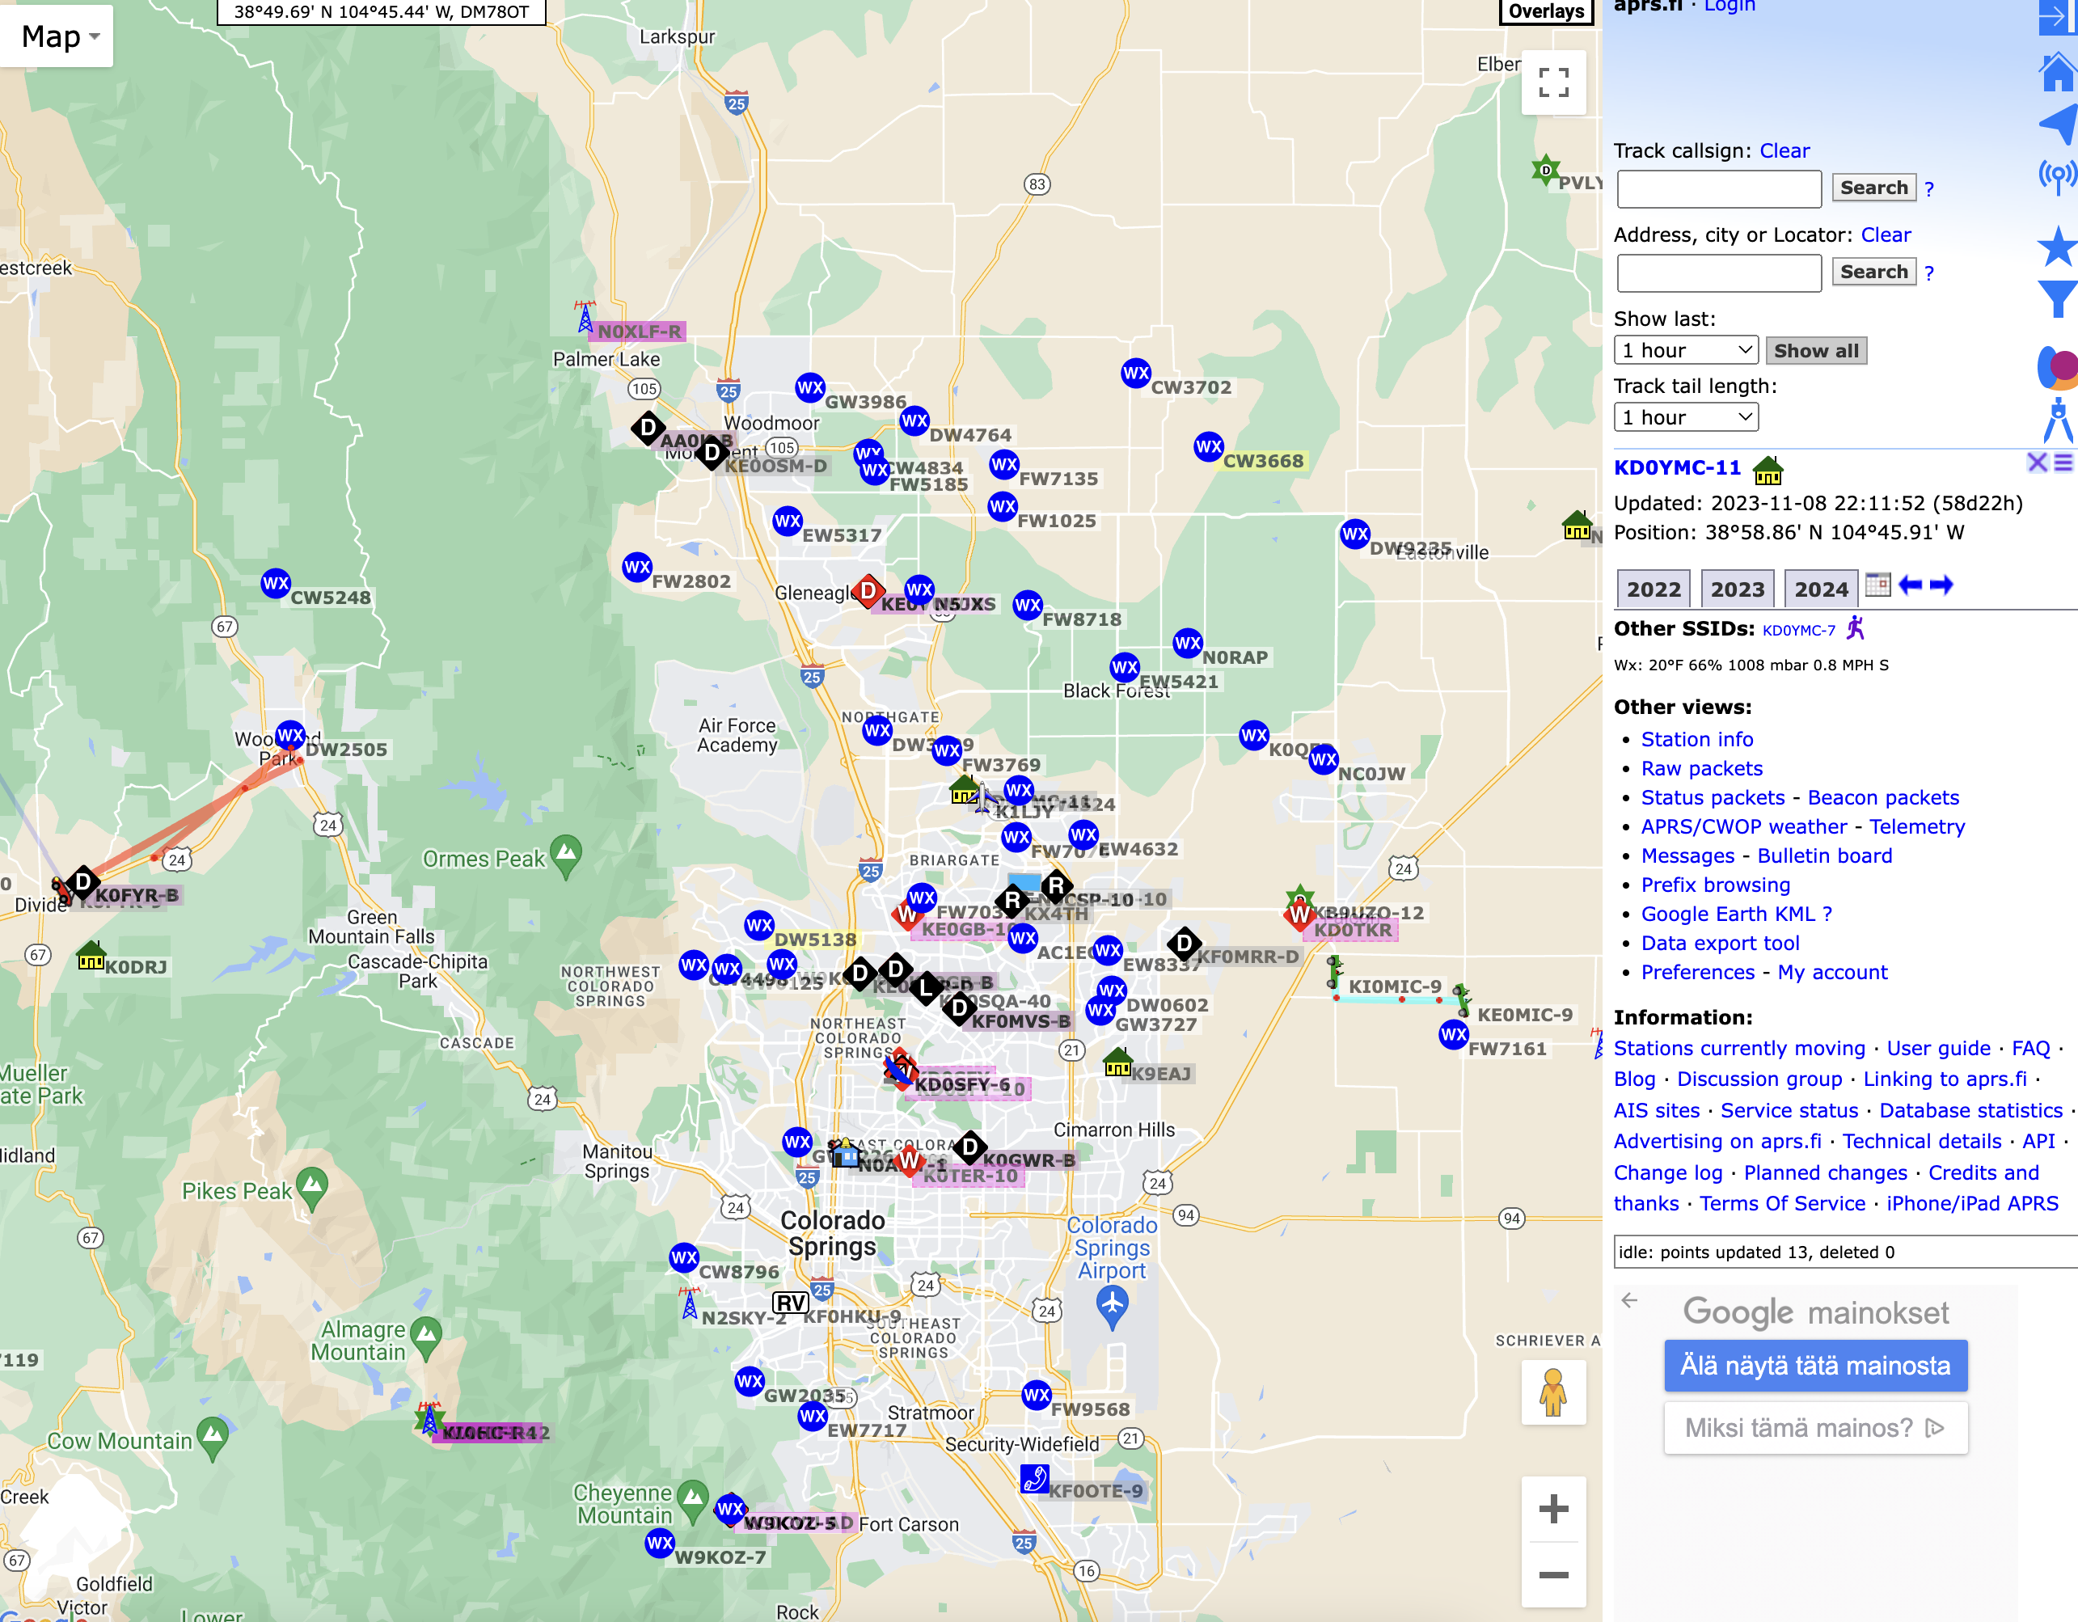
APRS.Fi Slides – Colorado Springs

Slide 19
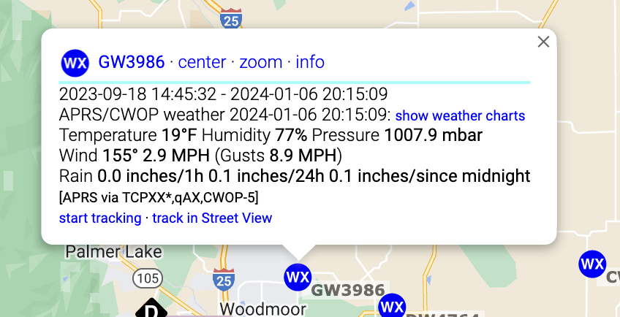
APRS.Fi Slides - Weather

Slide 20
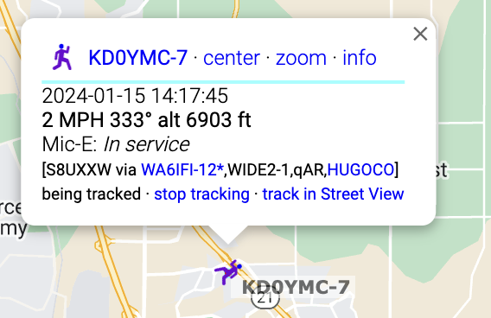
APRS.Fi Slides - Mobile

Slide 21
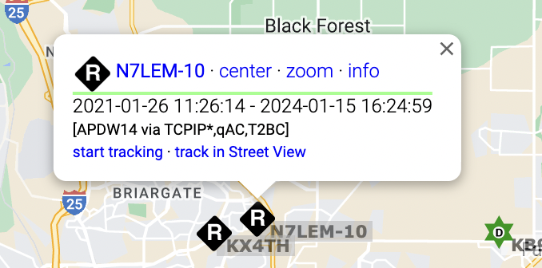
APRS.Fi Slides – I-Gate

Slide 22
Thank You

